Slide 1
Shark attacks
Tim lucas
Qixuan Wang
Karly Ringstad

Slide 2
Motivation
Core question:
How do key factors play a role in shark attack frequency and severity around the world?
Data source:
Kaggle
Global shark attack file - an organization that compiles current and historical shark attack data with direct links to case investigators for the purpose of forensic analysis to demonstrate the significance of human shark interactions.
url : https://www.kaggle.com/teajay/global-shark-attacks/version/7
Google Geocode API – Lat, Long for Mapping

Slide 3
Data cleanup
Issues:
- Thousands of data rows
- Thousands of unique data entries
- Blank entries
- Unnecessary columns
Resolutions:
- Filter data to years > 1959
- Replace unique values to fit into common categories and formats
- Fill in empty data values
- Remove unneeded columns

Slide 4


Research Questions
Is there a relationship between shark attacks and time of year?
Does the species of shark in an attack have an effect on the severity of the attack?
Is there a relationship between type of aquatic activity and frequency of attack?

Slide 5
Data analysis process
Import
Import new cleaned data csv
Run
Run aggregate functions using pandas
Create
Create plots using matplotlib, pandas, and GMAPS

Slide 6
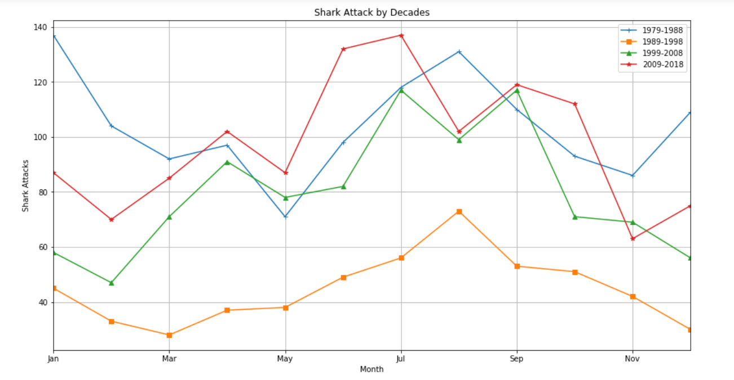
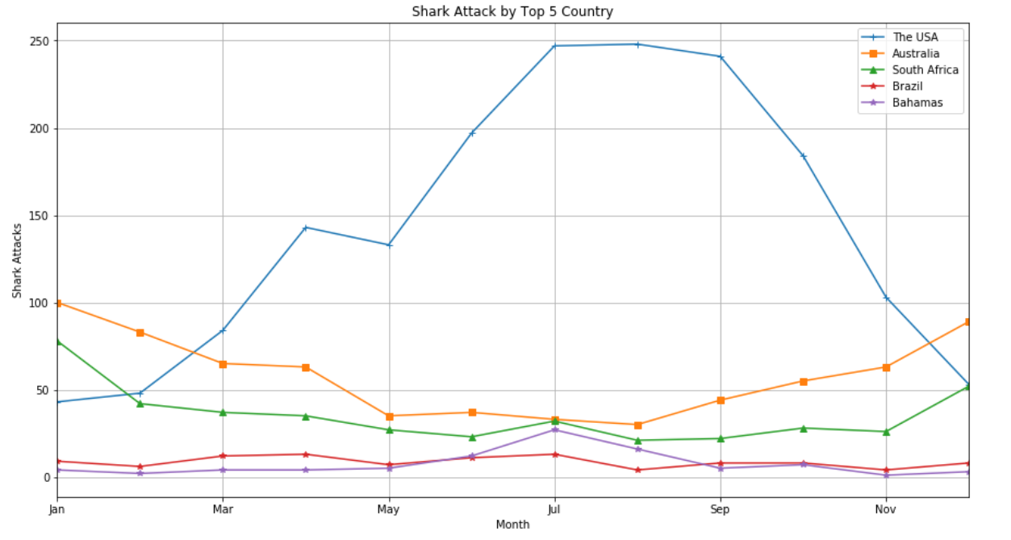
Time of year
Frequency of attacks by decade
Peaks in summer months (both hemispheres)
November appears to have a common drop in attacks
Last recorded decade appears to hit a new record high of attacks (July) compared to previous decades
Frequency of attacks by country
Top 5 countries with largest attack numbers
USA maintains the greatest number of attacks from march - november
spike in attacks during warmer months

Slide 7
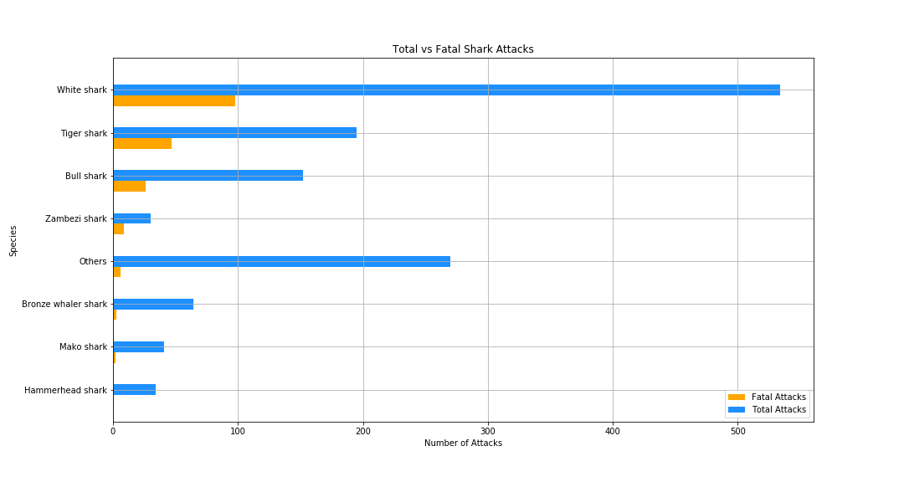
species
Total vs fatal attacks by species
White sharks maintain the largest number of both: total and fatal attacks

Slide 8
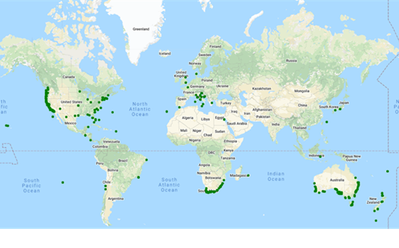
Fatalities by location and species
Total fatal attacks heatmap
Usa & AUS have the largest number of fatal attacks
Corresponds with Time of year graph
fatal attacks by white sharks
Usa & Aus also have the largest number of fatal attacks by white sharks
White shark attacks appear to cluster around specific areas

Slide 9
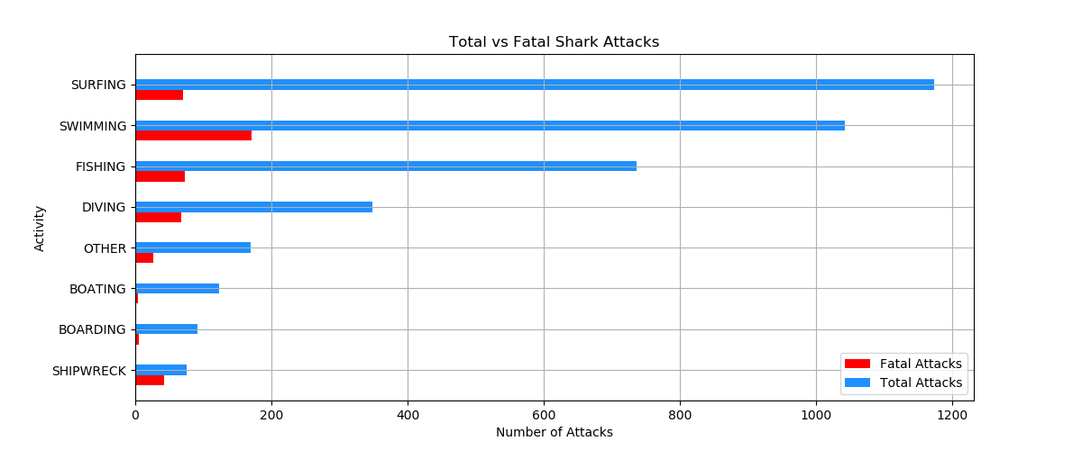
Activities
Surfing has the greatest number of attacks
Swimming has the greatest number of fatalities

Slide 10
summary
There does appear to be a relationship between Shark attacks and the time of year.
Jan – Mar: 857
Apr – Jun: 962
Jul – Sep: 1232
Nov – Dec: 857
The species of a shark is a key factor in the frequency and severity of the attack.
White Shark: 18% Fatality Rate (534 Attacks)
Bull Shark: 17% Fatality Rate (152 Attacks)
Tiger Shark: 24% Fatality Rate (195 Attacks)
Zambezi Shark: 30% Fatality Rate (30 Attacks)
Specific aquatic activties are more likely to see a shark attack.
Surfing: 1,173
Swimming: 1,042
Fishing: 736
Diving: 348

